Slide 1

Australia's Integrated Marine Observing System Animal Tracking Facility – advances and applications
Rob Harcourt
Oostende 22 April 2018

Slide 2
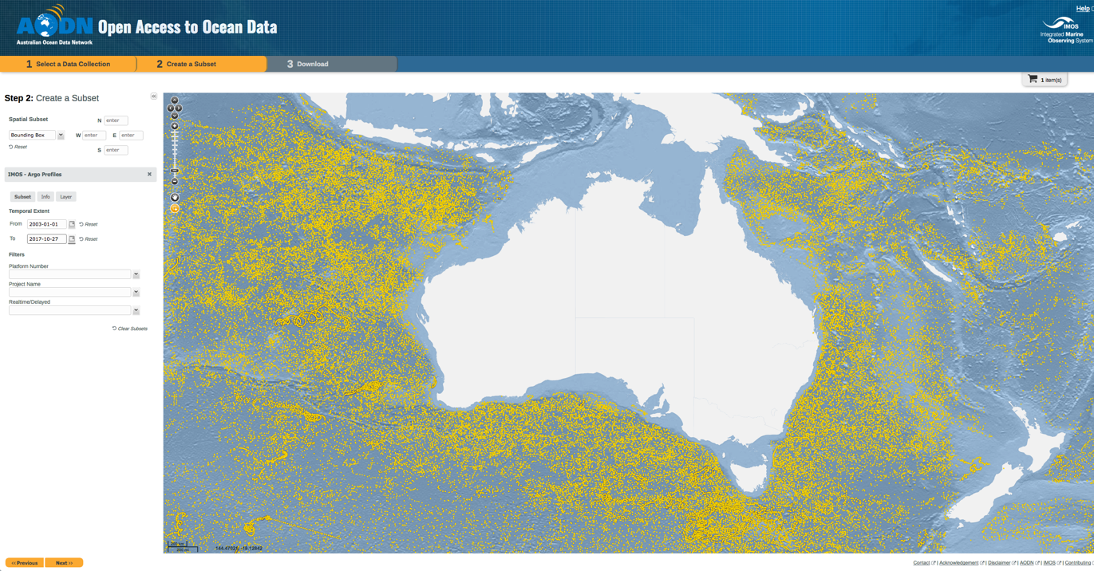
How does IMOS work?
All data collected is discoverable, openly accessible, usable and reusable

Slide 3
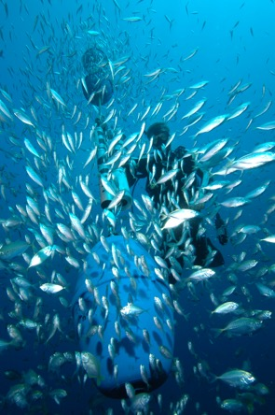
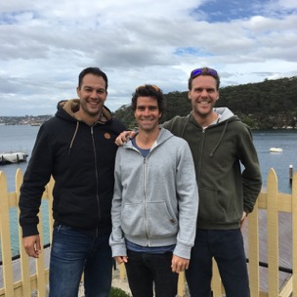
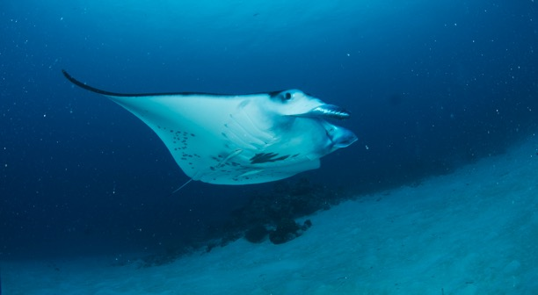
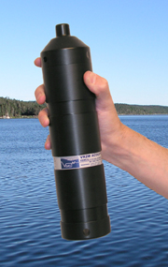
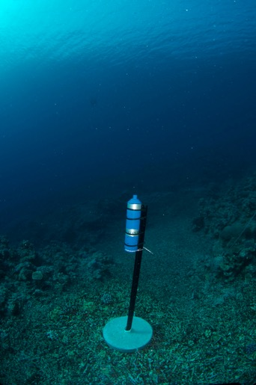
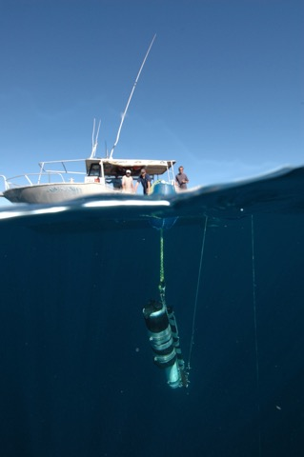
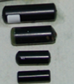
IMOS Animal Tracking Facility Acoustic network

Slide 4
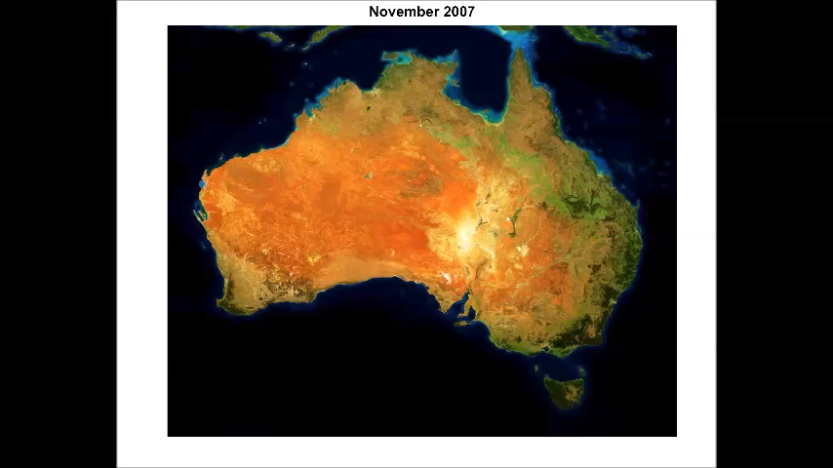
Extent of the IMOS-ATF network
Notes:
Insert animation

Slide 5

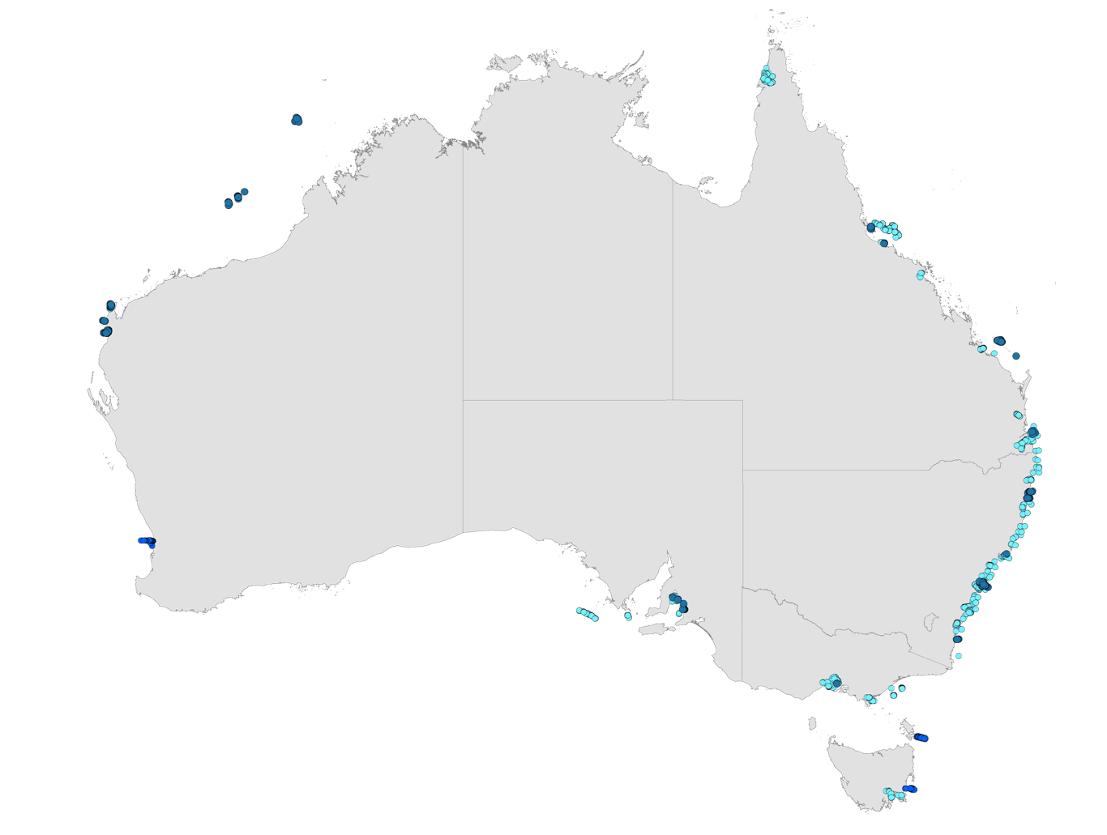
7574 Receiver deployments
7582 animals
137 species
NT
77.9 million detections
QLD
WA
SA
NSW
VIC
IMOS ATF array
Independent installations
Ocean Tracking Network installations
TAS

Slide 6
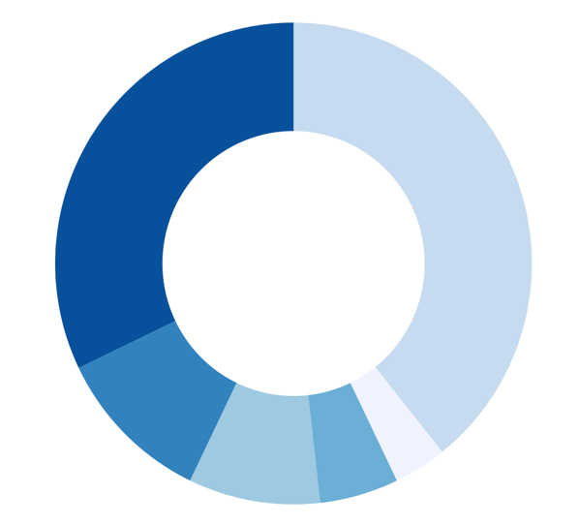

The IMOS ATF Community
>250 users
Government Organisations
"inside"
Universities
32%
40%
Other Research Institutes
11%
9%
5%
3%
For-Profit Organisations
International Partners
Not-for-Profit Organisations

Slide 7
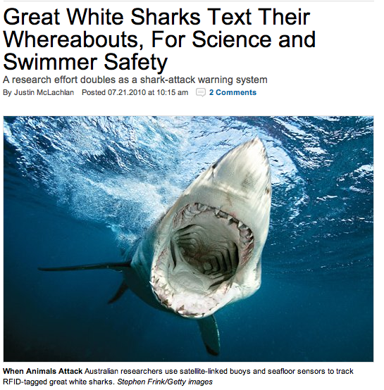
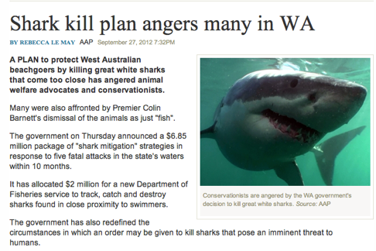
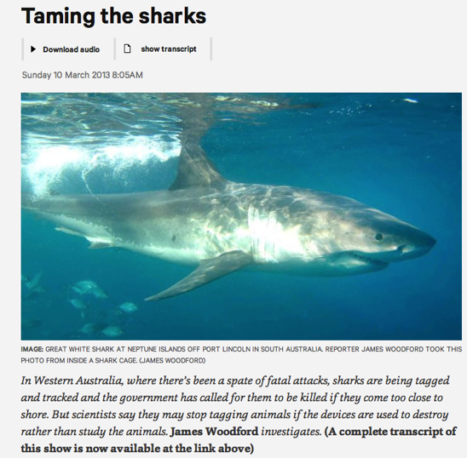
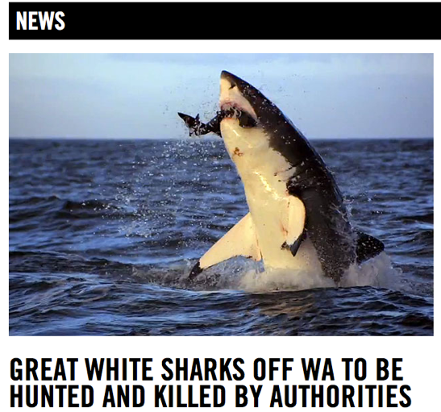
IMOS foundation ‘Publicly funded, publicly available’
BUT:

Slide 8
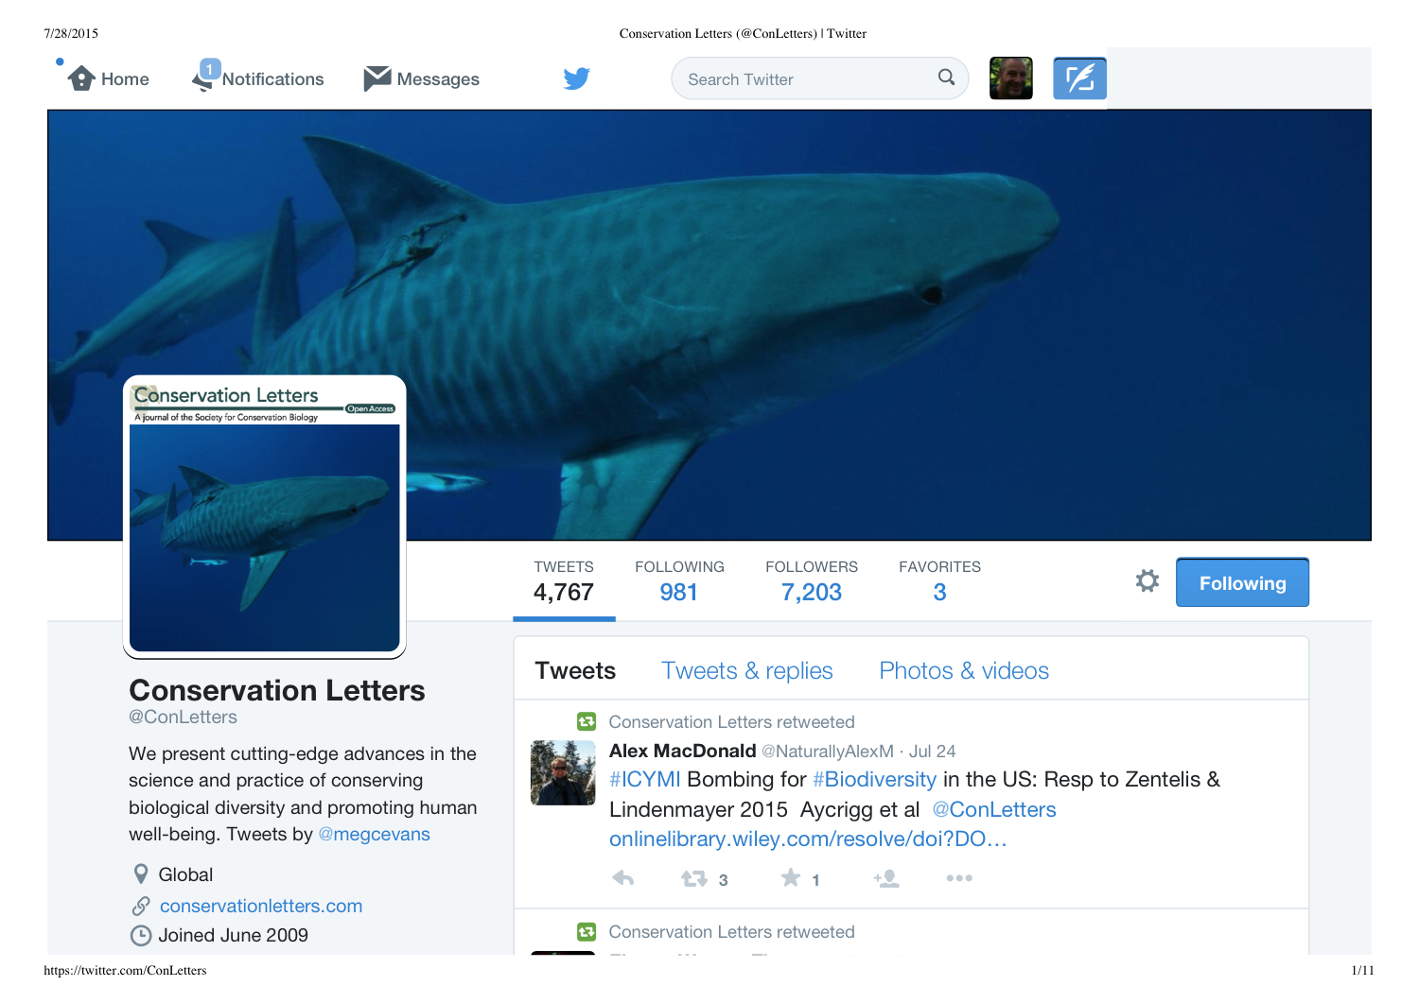

Slide 9
IMOS ATF revised data policy 2015
Three levels
1. Open Access
2. Embargoed data
Restricted access to tag data
12 months maximum, renewable
Ensures rights to first publication (primarily students)
3. Protected data
Restricted access to tag and associated detection data
No time limit
Significant criteria, significant risk (eg. species protection)
Watch this space- Preparing Tag Security paper with Steve Cooke and a cast of thousands

Slide 10
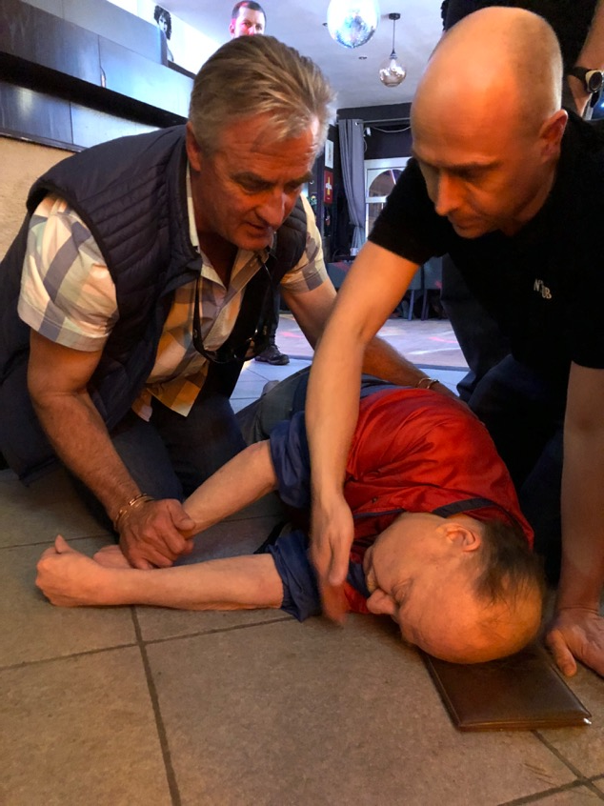
He didn’t share his data

Slide 11
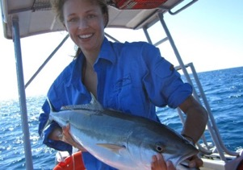
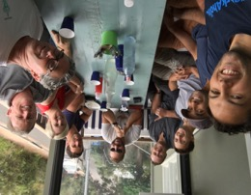
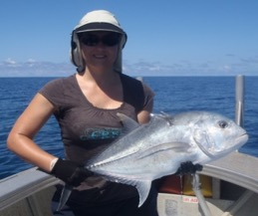
10 year review - Task Team
develop a national approach to data synthesis and analysis (Xavier)
inform future aspects of acoustic telemetry networks (Underway)
national scale analyses to aid fisheries and threatened species management (Brodie)
develop standardised approaches for large scale telemetry data analysis (Udyawer)

Slide 12

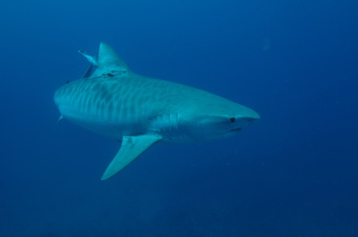
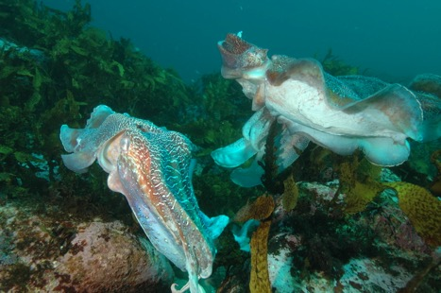
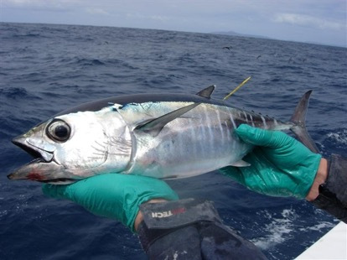
Continental-scale animal tracking reveals functional movement classes across marine taxa.
Brodie, S, Lédée, EL, Heupel, MR, Babcock, RC, Campbell, H, Gledhill, DC, Hoenner, X. Huveneers, C, Jaine, FRA, Simpfendorfer, CA, Taylor, M,D, Udyawer, V, Harcourt, RG. 2018.

Slide 13
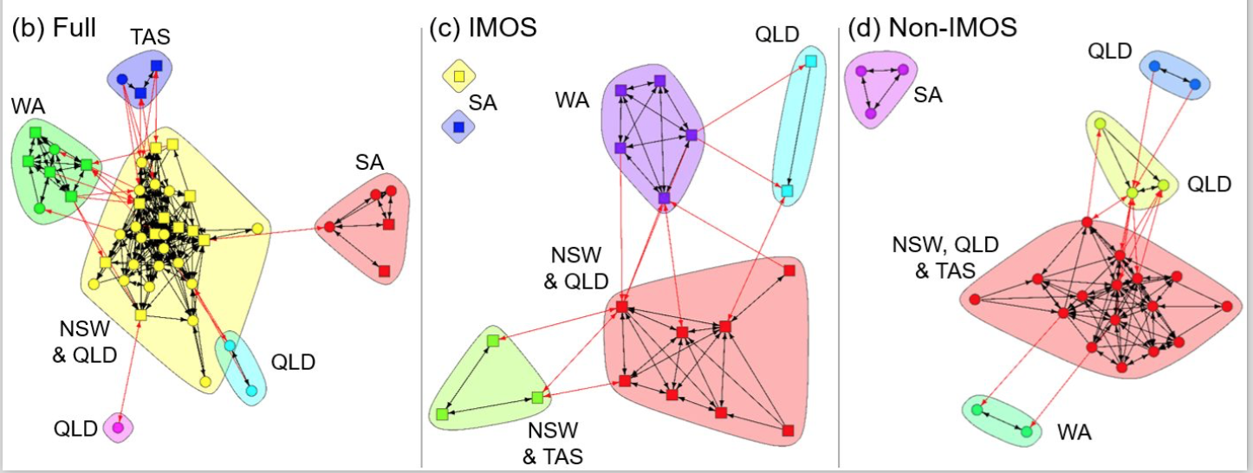

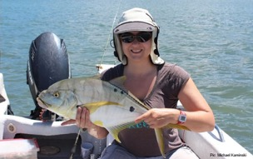

Networks with and without IMOS
47.7M detections 2,181 individuals, 92 species
Non-IMOS only
#Internationalwomenandgirlsinscience
Notes:
Unique network clusters for each installation type.
Clusters were a factor of geographic regions, indicated by state acronyms. Colors are not related between subplots.
Arrows indicate connection across installations between (red) and within (black) clusters.
Full network, many of the IMOS installations had a high level of centrality and connectedness as indicated by high installation strength and eigenvalues
IMOS installations alone produced a simpler network
non-IMOS installations alone resulted in a network with fewer paths, greater average path length, lower density, and larger diameter
IMOS installations in SA (c) have no connections and are considered isolate.

Slide 14
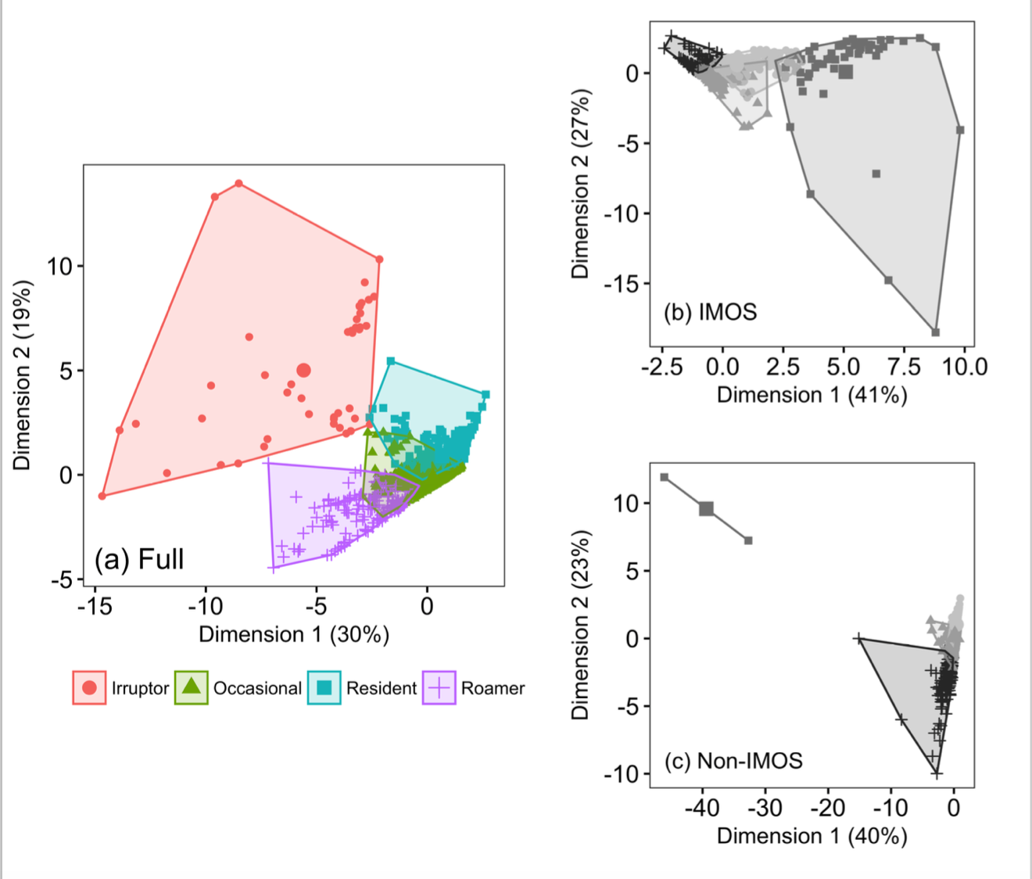

Functional Movement Classes
47.7M detections 2,181 individuals, 92 species
Notes:
Principal Components analysis- 4 significant clusters
‘Residents’ were frequently detected on a single installation or a limited number of near installations, representing site attached individuals with low level of dispersal. This FMC is exemplified by Lutjanus argentimaculatus. (Mangrove jack) a common recreationally fished species.
‘Occasionals’ were occasionally detected on a single installation or a limited number of near installations, i.e. they comprised site attached individuals with a medium level of dispersal e.g. Girella elevate or drummer, a reef dweller.
‘Irruptors’ were frequently detected on a limited number of near installations but also occasionally on distant installations- included site attached individuals that occasionally undertake long-distance movements such as Orectolobus maculatus, the spotted wobbegong or carpet shark.
‘Roamers’ were occasionally detected across a number of distant installations included nomadic individuals continually moving over a large area eg Rhincodon typus whale sharks.

Slide 15
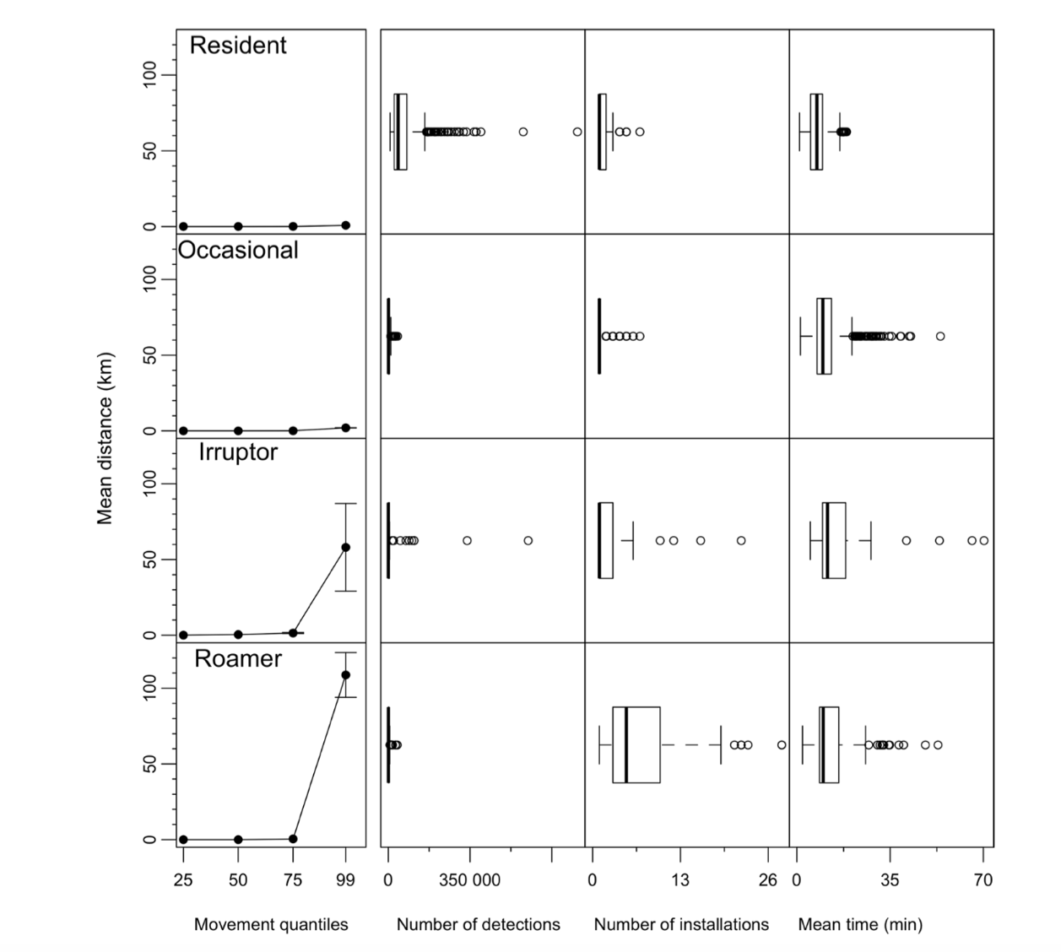
Notes:
Distribution of covariates that describe each functional movement class (FMC).
First column is the mean distance (km) for the 25%, 50%, 75%, 99% movement quantiles.
Remaining columns indicate the distribution of covariates: number of detections, number of installations at which a transmitter was detected, and the mean time between detections.

Slide 16
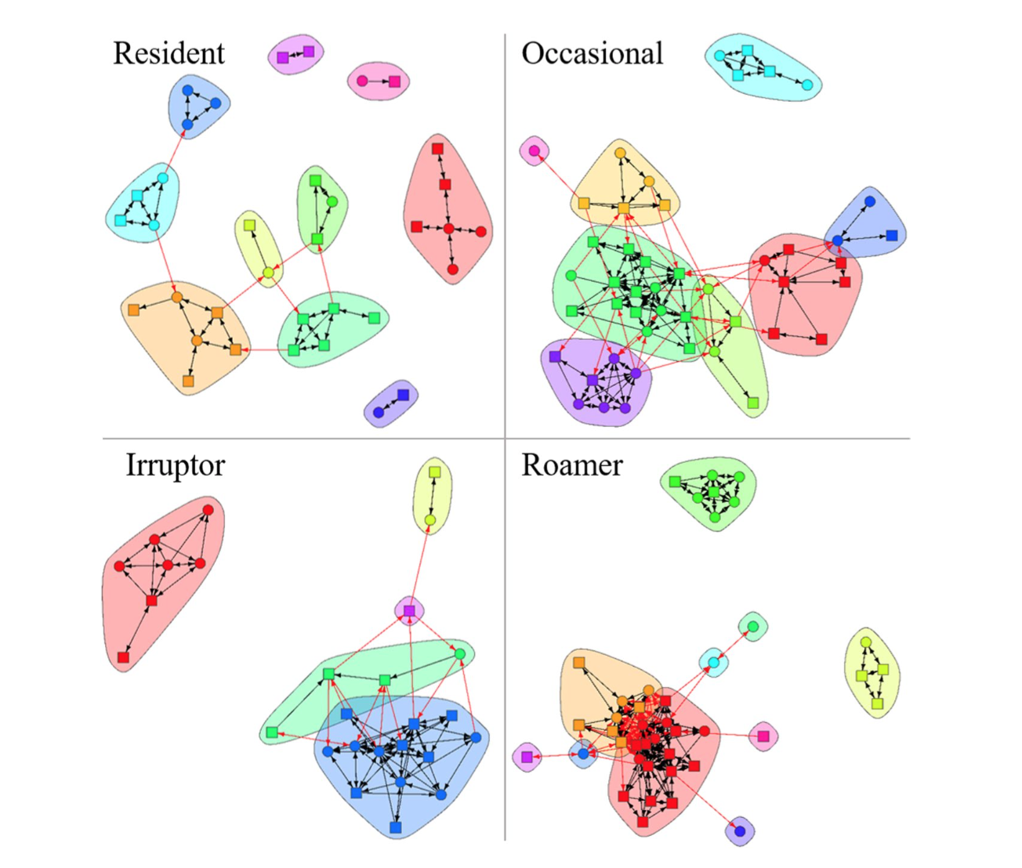
Notes:
Full installation networks for each functional movement class (FMC), with colors indicating unique clusters of closely related installations.
Colors between FMCs are not related, and cluster shapes are arbitrary.
Arrows indicate a connection across installations between (red) and within (black) clusters.

Slide 17
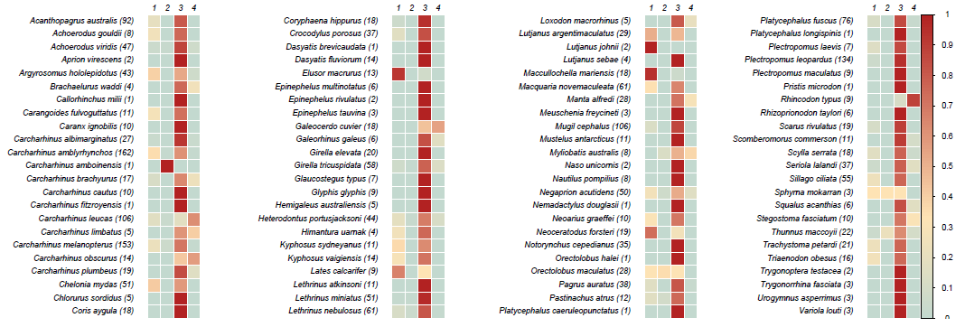
Classification of species
Key commercial species and TEPS identified by RPN as of national interest
Species | Reasons
Snapper | Coastal demersal, Stocks fished across multiple states, commercially & recreationally important
Kingfish | Pelagic, migratory, Stocks fished across multiple states, recreationally important
Flatheads (Sand, Bluespotted) | Coastal demersal, Stocks fished across multiple states, recreationally and Commercially important
Bream (Black, Yellowfin) | Coastal demersal. Stocks fished across multiple states, recreationally and commercially important
Spanish mackerel | Pelagic, migratory, Stocks fished across multiple states, recreationally and commercially important
Southern blue fin tuna | Pelagic, migratory, internationally commercially important (RFMO), increasing recreational catch
Tiger shark | TEPS - Large scale movements - interactions with humans
White shark | TEPS - Large scale movements - interactions with humans
Bull shark | TEPS - Large scale movements - interactions with humans
School shark | Demersal, south east Australian distribution, commercially important, conservation dependent

Slide 18


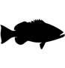





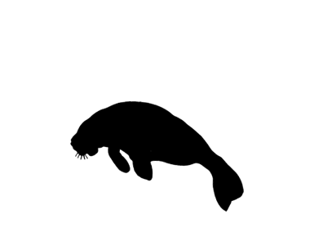
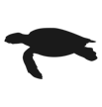

Multi-species inventory- 117 species- inverts to mammals
35 species
57 species
3 species
17 species
1 species
2 species

Slide 19
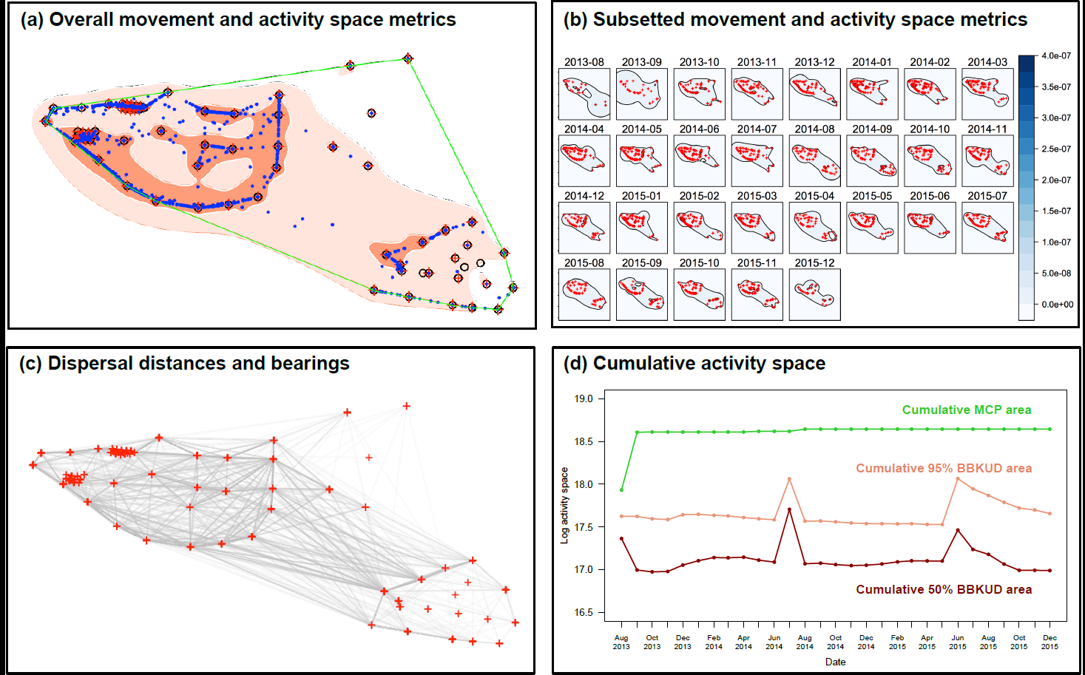

Standardised metric dashboard
Notes:
Detection metrics
Number of detections
Number of days detected
Number of receivers detected on
Dispersal metrics
Center of Activity positions
Activity space metrics (overall and subsetted)
MCP -Minimum Convex Polygons
Brownian bridge KUD

Slide 20
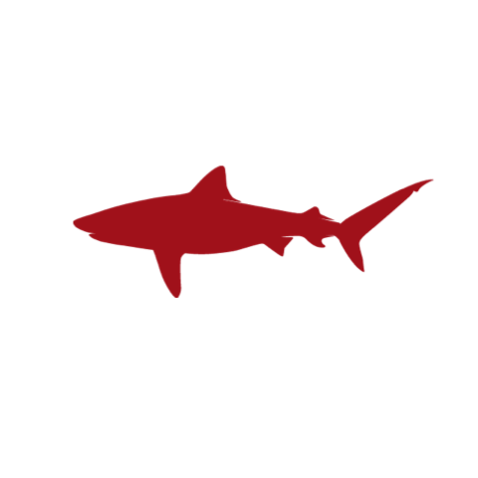
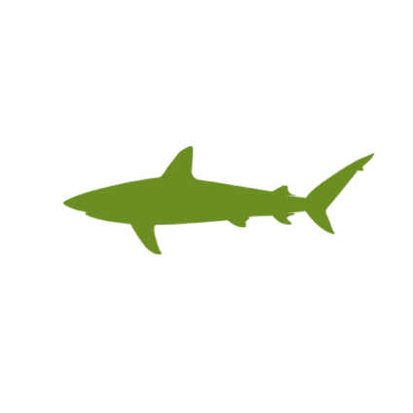
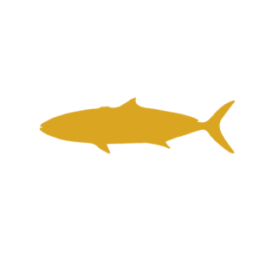
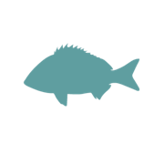
Case Studies
Case studies to demonstrate continental-scale and multi-species comparisons using the Acoustic Tracking Toolbox
Case study 1: Activity space and movement patterns of multiple species across multiple study sites
Case study 2: Activity space and movement patterns of multiple species within a single site
Case study 3: Examining temporal patterns in activity space in multiple species
Yellowfin Bream
Yellowtail Kingfish
Grey Reef Shark
Bull Shark

Slide 21
Case Study 1: Multi-site, multi-species comparison
Brownian Bridge KUD Parameterisation of smoothing factor enables direct comparison
Activity space Standardisation enables inter-specific comparisons between sites
Standardised metrics can be used for comparison with other species

Slide 22
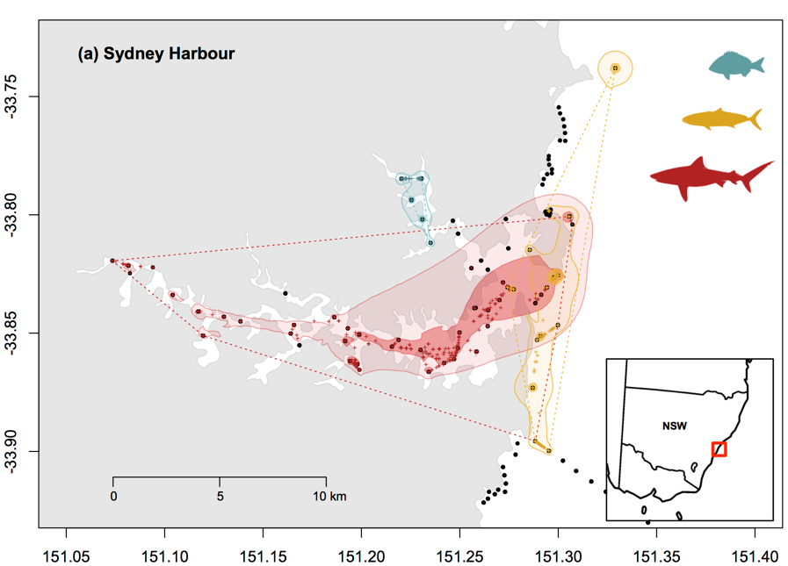
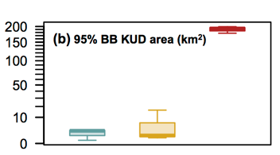
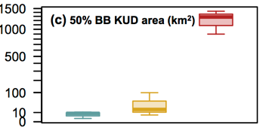
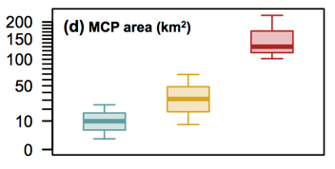
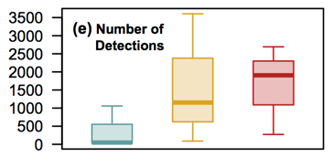
Case Study 2: Multi-species, single site comparison- multi-guild system Sydney Harbour
Direct comparisons between trophic groups within a single site

Slide 23
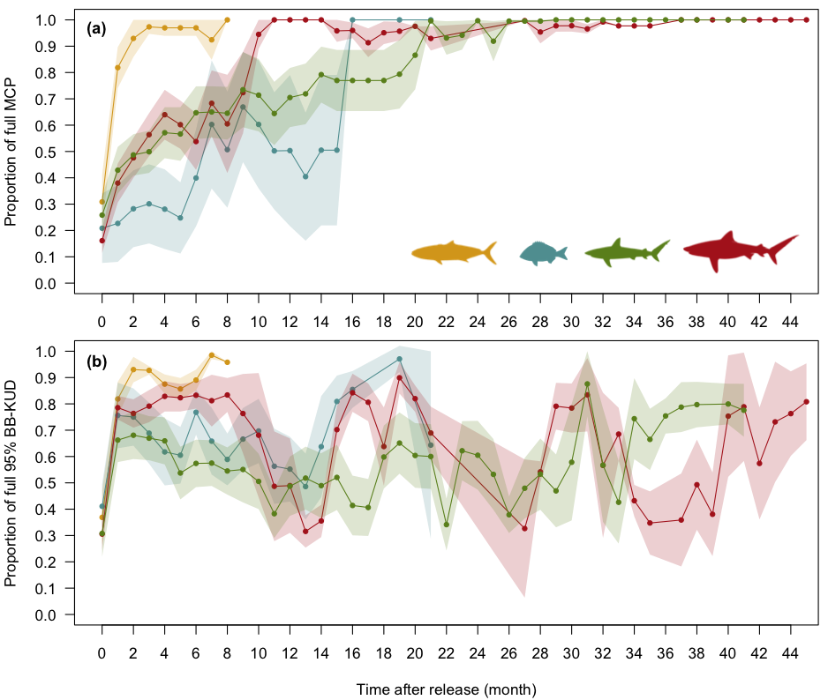
Case Study 3: Temporal patterns in activity space
Temporal subsetting and calculation of cumulative growth in activity space
Cumulative Minimum Convex Polygon metrics help understand stability of calculated activity space
Cumulative growth in Brownian Bridge KUD highlights patterns in movement-related activity space

Slide 24
Animals as Ocean Sensors: Entering the Era of Integrated Marine Observing

Slide 25

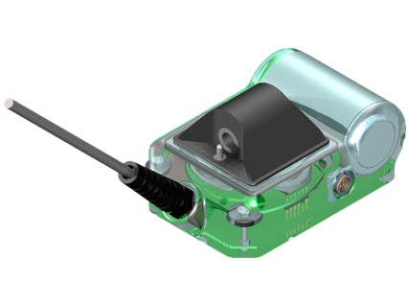
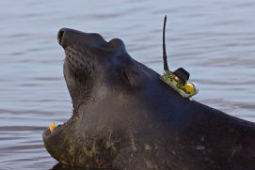
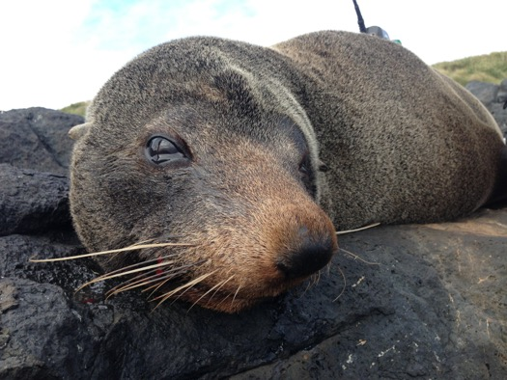
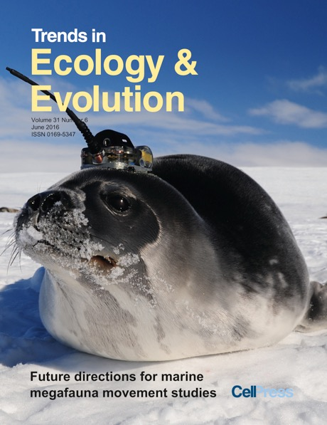
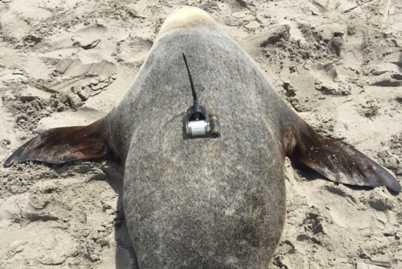
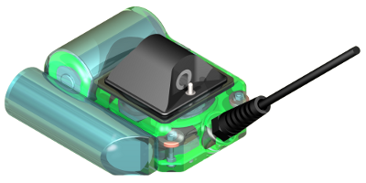
IMOS Animal Tracking Facility: Seals as Oceanographers
CTD Oceanography SRDL (Argos)
Robert Harcourt & Clive R. McMahon
CTD/Fluorometer Oceanography SRDL (Argos)

Slide 26
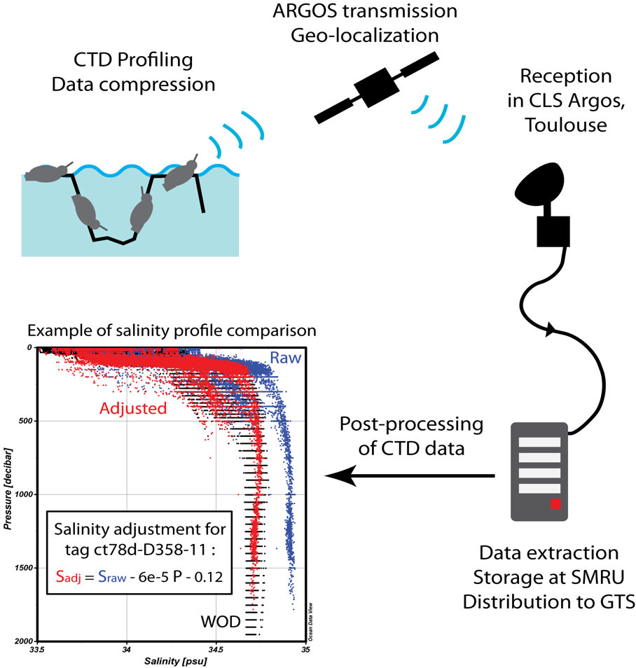

IMOS Animal Tracking– data transmission
Deployments on land
Data available publicly @:
1) IMOS Ocean Portal
2) British Oceanographic Data Centre (BODC) portal
3)MEOP
Roquet et al 2014 Nature Scientific Data
Notes:
An overview of the procedure used to collect oceanographic data using instrumented elephants seals. The CTD-SRDL is attached on the seal on land, then it records hydrographic profiles during seal foraging trips, sending the data by satellite ARGOS whenever the seal goes back to the surface. Position of seals is obtained by triangulation from ARGOS satellites. Data are then extracted, formatted and stored at the Sea Mammal Research Unit (SMRU), and transmitted in real-time to the Global Telecommunication System (GTS). A post-processing procedure is applied on the CTD data, including the editing, adjustment and validation of hydrographic profiles. Finally, data are made available publicly through the British Oceanographic Data Centre (BODC) portal.

Slide 27


MEOP (2004-2017) & IMOS (2007-2017) data marine mammals exploring pole to pole
MEOP CTD casts – 302 175 Australia CTD casts 107 365
http://www.meop.net/
Treasure et.al. 2017 Oceanography

Slide 28


Scaling, or not, on a global basis
Notes:
analyzed the movement patterns of 50 marine vertebrate species, including whales, seals, seabirds, polar bears, sharks, manatees, and turtles. Unlike terrestrial animals, movement patterns in marine animals were strongly conserved across species. Movement patterns were more complex near the coasts than in the open oceans, suggesting that the patterns are heavily influenced by the habitats through which the animals move, with implications for conservation

Slide 29


Allometry less important than habitat for movements

Slide 30
RAATD: Reanalysis of Antarctic Tracking Data
Ocean Tracking Synthesis
Hindell, Block, Sims, Costa, Harcourt, Jonsen, Ropert-Coudert

Slide 31







Developing the Next Generation of Animal Telemetry Tools
Ian Jonsen
MQ Research Fellow
2018-2021

